Slide 1
Food and Beverage Management The sixth edition
Chapter 5
Food Production

Slide 3
Chapter 5 covers:
Types of menus
Menu planning
Menu costing and pricing
Food production systems
Volume in food production
Purchasing
Operational control

Slide 4
Purpose of the menu
Selling aid – method of communication
Adequate information, easily found and followed, will make the customer feel more at home and will assist in selling the menu

Slide 5
Types of menu
All menus, no matter how simple or complex, are based on the two basic menu types:
table d’hôte (set price for a number of courses)
à la carte (individually priced)
Some menus offer combinations of these two classes

Slide 6
Other menu terms
Carte du jour (literally card of the day)
Menu du jour - Menu of the day
Prix fixe (fixed price)
Tasting menu (‘menu degustation’)
Tasting menus can also be offered with a flight (selection) of wines
Tapas
Meze
For all menus the price of the meal might also include wine or other drinks

Slide 7
Classic menu sequence
Canapés and amuse bouche
Starters / Appetisers Hors-d’oeuvres
Soup
Egg dishes
Pasta and rice
Fish
Sorbet
Meat, poultry, game, vegetarian, vegan and plant-based
Potatoes, vegetables, salads
Cheese
Sweets / desserts (most often now called dessert)
Savoury
Fruit

Slide 8
Most simple menu
Might comprise:
Starters/appetisers
Main courses
To follow / Afters (cheese/sweet)

Slide 9
Modern menu structures
Classic menu sequence derived from traditional European cuisines and service influences
Menu structure and menu sequences change considerably within the various world cuisines
Menu terms are culturally bound and vary with location

Slide 10
Meal traditions
Most commonly breakfast, lunch, afternoon tea and dinner
Some operations have broken away from these traditions by offering all day meus

Slide 11
Menu construction
In addition to traditional meal types there are demands for:
Special party or function menus
National or specialty menus
Hospital menus
Menus for people at work
Vegetarian and vegan menus
Menus for children
Floor/room service menus
Lounge service menus
Airline tray service menus
Rail service menus

Slide 12
Menu policy
Developed to:
Establish the needs of the customer
Predict what the customer is likely to buy
Ensure a means of communication with customers
Determine how much the customer will spend
Ensure efficient purchasing and preparation
Keep within profitably objectives
Effectively control the operation

Slide 13
Key influences on menus
Gastro-history and gastro-geography
Relationship between health and eating
Dietary requirements including cultural and religious influences
Vegetarianism
Prominent chefs and media
Trends, fads and fashions
Ethical and sustainability considerations

Slide 14
Local gastronomy a result of:
Gastro-geography - determines how foods and beverages, cooking methods, customs and eating habits are, and have been, influenced by climate, soil, crops, history, tradition, psychology, commerce and the peoples
Gastro-history - determines the influences of the places surrounding a location, and also those beyond, with which the peoples have been, and are, involved

Slide 15
Health and eating
Relationship between health and eating is about having a healthy diet
Individual foods or drinks are not more healthy or less healthy
Customers want:
Availability of choices
More specific information on ingriedients and methods of cooking used

Slide 16
Medical dietary requirements
Includes prevention of allergic reactions
Customers need to know about the ingredients
Certain things may cause illness or be fatal
Server must:
Be accurate
Never guess
Seek further information if in any doubt

Slide 17
Allergens and intolerances
Allergens - It is a legal requirement for food businesses to provide information on 14 specified allergenic ingredients
Food intolerance - more common than food allergies – e.g., gluten intolerance (coeliac disease), lactose intolerance, or garlic intolerance

Slide 18
Other dietary requirements
Cultural and religious including:
Hindus; Jews; Muslims; Sikhs; Rastafarians; Roman Catholics
Vegetarianism including:
semi; lacto-ovo; lacto; vegans; fruitarians
Pescatarian

Slide 19
Prominent chefs and media
Great influence by prominent chefs
Also from:
Media generally
Social media
Chef, cookery and consumer programmes

Slide 20
Trends, fads and fashions
Trends: developments in technology, cuisine and restaurant styles that lead to long term adoption
Fads and fashions: things that appear, are widely adopted, and just as quickly disappear

Slide 21
Ethical influences
Sustainability of food supply chain
Fair trade
Acceptability, or otherwise, of genetically modified or irradiated foods
Reducing food packaging and food waste
Reducing the effects that food production has on the environment generally

Slide 22
Essential knowledge
Server must know what they are serving
The service requirements
How to advise the customer on:
the content of dishes
the methods used in making the dishes
the accompaniments offered

Slide 23
Developing menus
Essential considerations:
Location and competition
Customer needs and spending power
Number of items and price range of menus
Potential throughput
Space and equipment required
Amount, availability and capability of labour
Supplies and storage
Accuracy of costing
Nutritional information

Slide 24
Menu construction
Daily menus
Pre-planned / pre-designed
Cyclical menus

Slide 25
Menu content and design
Can be presentation in a variety of formats
Need to ensure the look and feel of the menu matches the overall design of the restaurant
And must include:
Clear and accurate descriptions
Clear indication of pricing
Dietary information
Items or groups of items with names customers recognise and understand

Slide 26
Menu layout
Tactics include:
Highlighting customer favourites to draw attention to them
Placing more profitable dishes in first and last position on the menu
Keeping prices in the body of the description paragraph
Using illustrations and photos
Responding to eye gaze motion theory
Keeping current by evaluating every six months

Slide 27
Menu copy
Approaches to menu copy include:
Ensuring sufficient description to aid understanding
Ensure right emphasis is given
Culinary terms properly used
Names are those people recognise and understand
Emphasis is maintained by good use of print size and style

Slide 28
Menu costing and pricing
To cost a dish, the minimum information required is:
The finished portion size
The recipe used to produce the dish
The ingredient cost (including everything required for that dish)

Slide 29
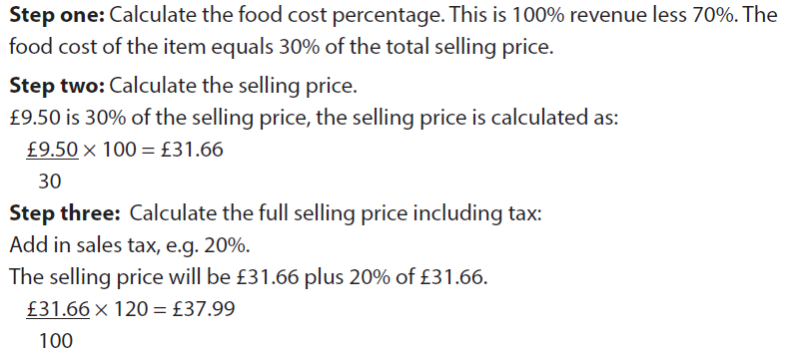
Cost plus example
Main course with overall food cost of £9.50 Required gross profit margin of 70 per cent

Slide 30
Pricing methods
The cost plus method is attractive because of its simplicity, but there are problems with it
Often a combination of different pricing methods is used.

Slide 31
Kitchen management
Legacy of Escoffier
Partie system (product based approach)
Standard cuisine terms
Vast development in cooking techniques and equipment
Operations now rationalised and redesigned for efficiency
Alternative process approach (based on production techniques and processes)

Slide 32
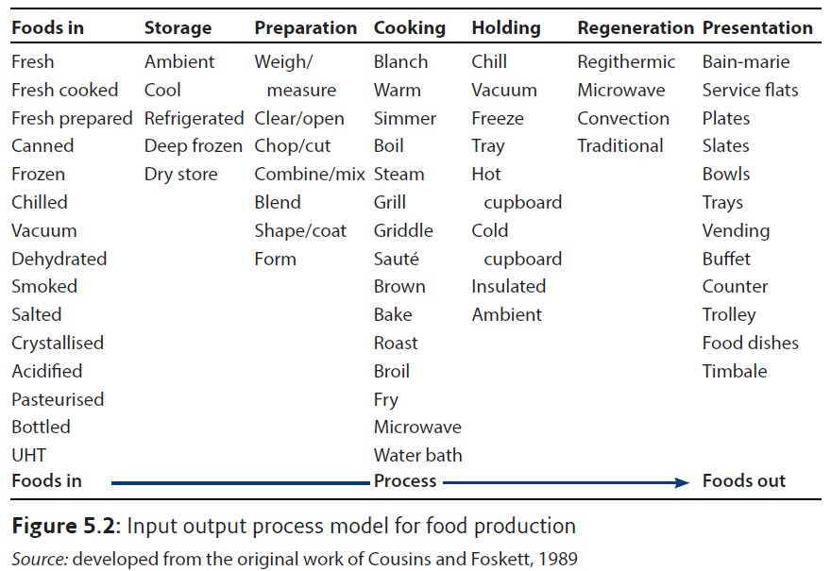
Elements of food production

Slide 33
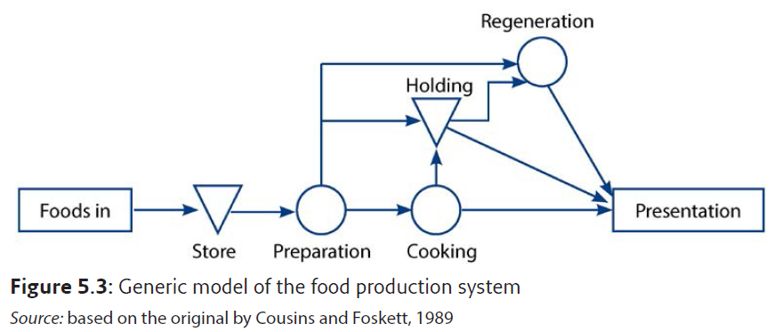
Generic model of food production system

Slide 34
Methods of food production
Conventional
Convenience
Call order
Continuous flow
Centralised
Cook-chill
Cook-freeze
Sous-vide
Assembly kitchen

Slide 35
Volume in food production
Seven stages of the food production process
Foods in
Storage
Preparation
Cooking
Holding
Regeneration
Presentation
Each has an effect on the potential volume of the operation

Slide 36
Purchasing
Six steps for successful purchasing and receiving functions:
Know the market
Determine purchasing needs
Establish and use specifications
Design the purchase procedures
Ensure accurate receiving
Evaluate the purchasing task

Slide 37
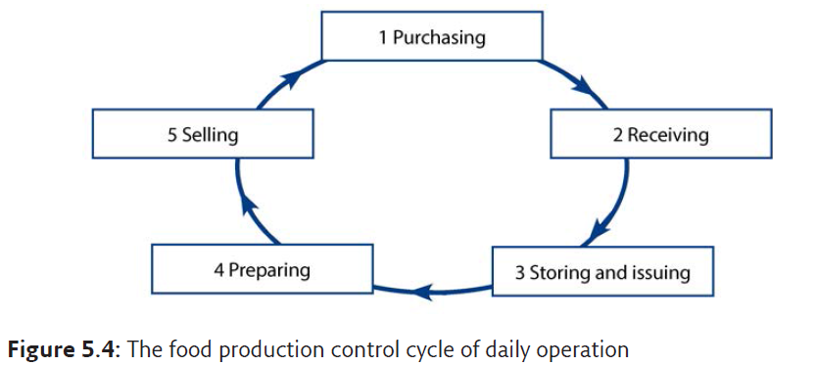
Operational control cycle

Slide 38
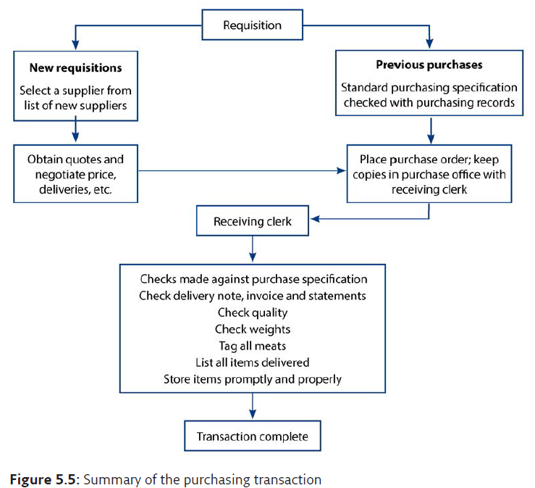
Summary of purchasing transaction

Slide 39
Control and profitability
Summary of the key factors:
Efficient preparation of raw materials
Correct cooking of food to minimise portion loss
Correct portion control
Minimising wastage and reducing theft
Accurate ordering and checking procedures
Reference marks to standardised recipes and yield factors
Sufficient research into suppliers
Accurate forecasting and sound menu planning

